Slide 1
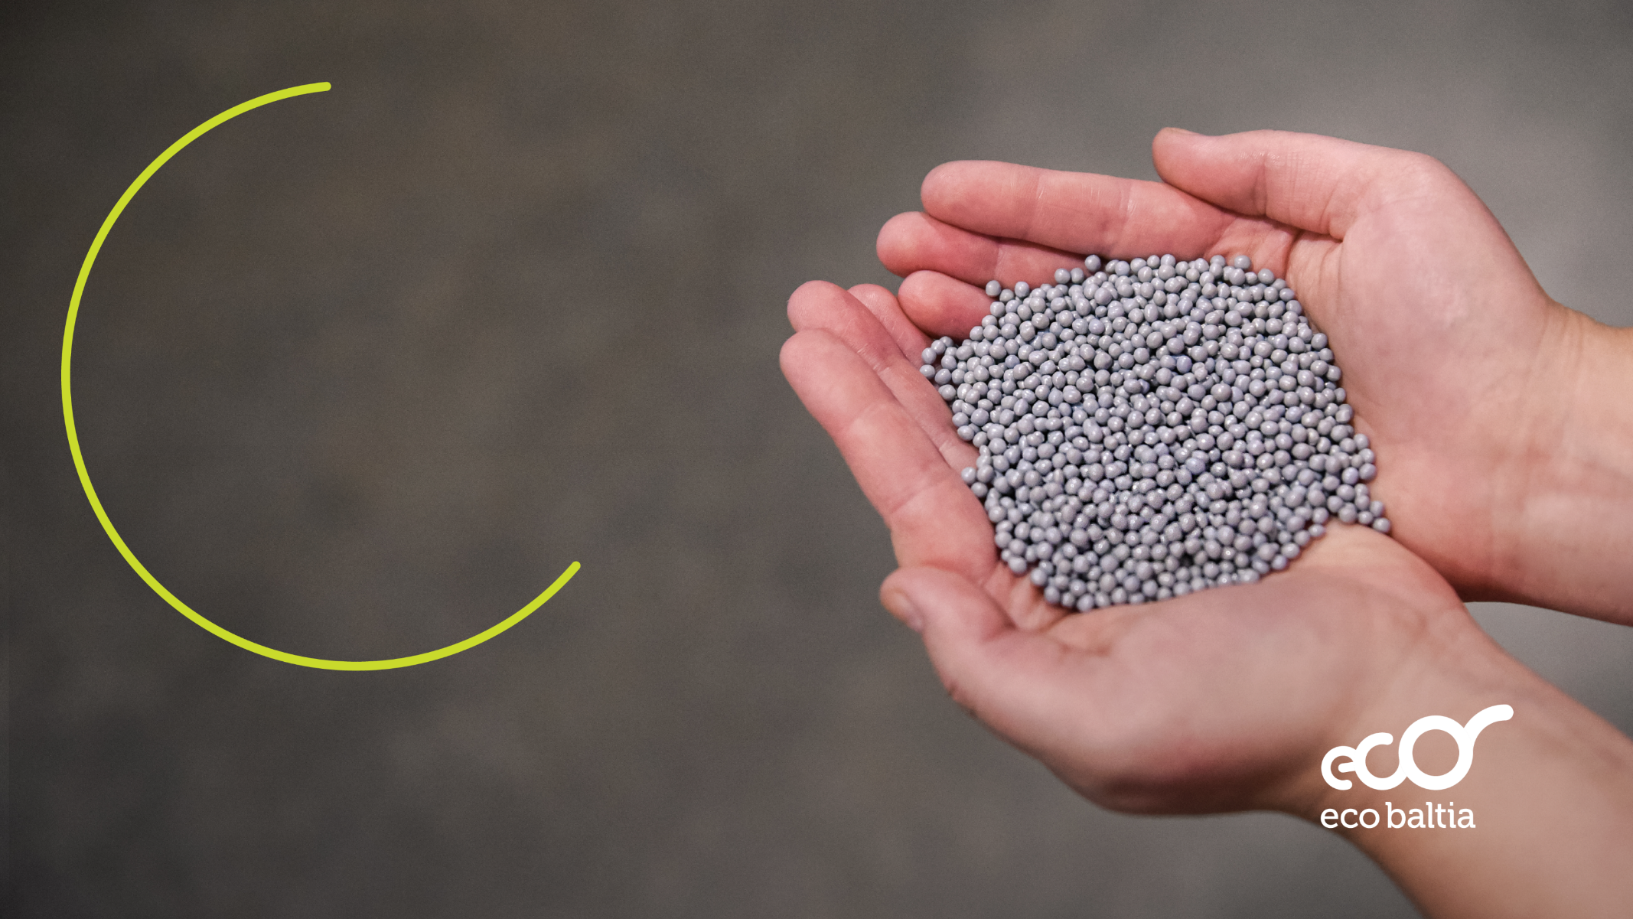
Eco Baltia
Largest environmental and waste management group in the Baltics

Slide 2
DISCLAIMER
This Presentation (as deﬁned hereafter) has been prepared by Eco Baltia, AS (the “Company” and together with its subsidiaries the “Group”). “Presentation” means this document, its contents or any part of it, any oral presentation, any question or answer session and any written or oral material discussed or distributed during the presentation meeting or otherwise in connection with it. This Presentation is strictly conﬁdential and may not be copied, distributed, reproduced or passed on, directly or indirectly, in whole or in part, or disclosed by any recipient, to any other person or published in whole or in part, for any purpose or under any circumstances.
This Presentation does not constitute or form part of, and should not be construed as, any oﬀer to sell or issue or invitation to purchase or subscribe for, or any solicitation of any oﬀer to purchase or subscribe for, any securities of the Company, nor shall it or any part of it nor the fact of its distribution form the basis of, or be relied on in connection with, any contract or investment decision.
The distribution of this Presentation may be restricted by law in certain jurisdictions and persons into whose possession any document or other information referred to herein come should inform themselves about and observe any such restriction. Any failure to comply with these restrictions may constitute a violation of the securities laws of any such jurisdiction.
The information contained in this Presentation does not purport to be comprehensive and is subject to updating, completion, revision and amendment and such information may change materially. None of the Company, any of its shareholders, any of its or their ﬁnancial or other advisors, any of their respective subsidiary undertakings or aﬃliates, or their respective directors, oﬃcers, employees, advisers or agents accepts any responsibility or liability whatsoever for/or makes any representation or warranty, express or implied, as to the truth, fullness, accuracy or completeness of the information in this Presentation (or whether any information has been omitted from the Presentation) or any other information relating to the Group, whether written, oral or in a visual or electronic form, and howsoever transmitted or made available or for any loss howsoever arising from any use of this Presentation or its contents or otherwise arising in connection therewith. Each of such persons accordingly disclaims all and any liability whatsoever, whether arising in tort, contract or otherwise in respect of this Presentation
or any such information.
The information in this Presentation may include forward-looking statements, which are based on current expectations, projections and assumptions about future events. These forward-looking statements include all matters that are not historical facts. These
forward-looking statements as well as those included in any other information discussed in the
2
Presentation are subject to known or unknown risks, uncertainties and assumptions about the Group and its investments, including, among other things, the development of its business, its growth plan, trends in its operating industry, its future capital expenditures and acquisitions. In light of these risks, uncertainties and assumptions, the events in the forward-looking statements may not occur and actual results, performance or achievements may materially diﬀer from any future results, performance or achievements that may be expressed or implied in this Presentation. No representation or warranty is made that any forward-looking statement will come to pass. Forward-looking statements speak as of the date of this Presentation and no one undertakes to release any update or revision of any such forward looking statement, whether as a result of new information, future events or otherwise. Accordingly, undue reliance should not be placed on any forward-looking statement contained in this Presentation.
To the extent available, the industry, market and competitive position data contained in this Presentation come from oﬃcial or third-party sources. Third party industry publications, studies and surveys generally state that the data contained therein have been obtained from sources believed to be reliable, but there is no guarantee of the accuracy or completeness of such data. While the Company reasonably believes that, each of these publications, studies and surveys has been prepared by a reputable source, neither the Company, its shareholders, or any of its or their ﬁnancial or other advisors, have independently veriﬁed the data contained therein. In addition, certain of the industry, market and competitive position data contained in this Presentation come from the Company’s own internal research and estimates based on the knowledge and experience of the Company’s management in the markets in which the Group operates. While the Company reasonably believes that such research and estimates are reasonable and reliable, they, and their underlying methodology and assumptions, have not been veriﬁed by any independent source for accuracy or completeness and are subject to change. Accordingly, undue reliance should not be placed on any of the industry, market or competitive position data contained in this Presentation.
Certain ﬁnancial and statistical information contained in this Presentation is subject to rounding adjustments. Accordingly, any discrepancies between the totals and the sums of the amounts listed are due to rounding. Certain ﬁnancial information and operating data relating to the Company contained in this Presentation has not been audited and in some cases is based on management information and estimates, and is subject to change. This Presentation may also include certain non-IFRS measures, which have not been subject to a ﬁnancial audit for any period. The Company’s interim ﬁnancial and operational data may not be representative of its data for the full year.

Slide 3
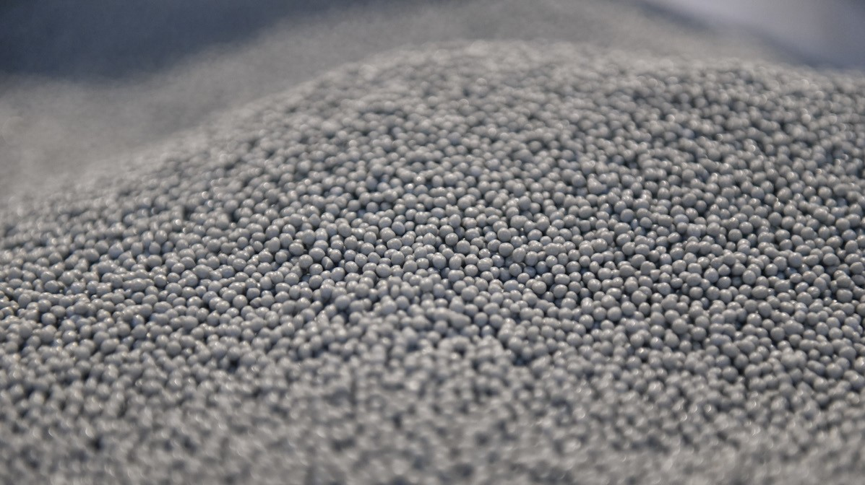

OVERVIEW
01

Slide 4
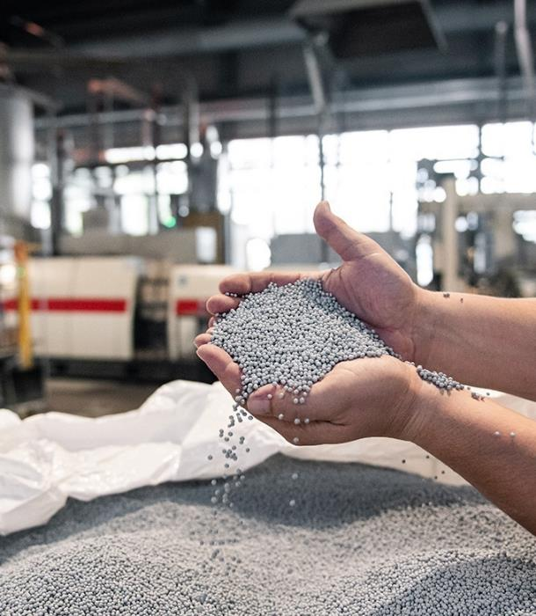

GENERAL OVERVIEW
Eco Baltia is the largest vertically integrated multi-service environmental services group in Baltics
As pioneers in the industry, Eco Baltia was the first to establish a PET bottle recycling plant in the Baltic States under PET Baltija
Eco Baltia has a modern asset base, able to meet the most demanding needs of our customers
Backbone of Circular Economy in Baltics with high growth potential
Company rankings are determined through peer comparison based on turnover data sourced from commercial registries.

Slide 5
ECO BALTIA KEY POINTS
Leading waste management provider
WELL-INVESTED ASSET BASE…
…RESULTING IN LARGE CAPACITIES
30
Number of facilities, across Latvia, Lithuania, Poland and Czech Republic
>250
kt
p.a.
Processing capacity
LEADER IN THE BALTICS REGION
SIZABLE AND GROWING BUSINESS
#1
Leading waste management provider in the Baltics
EUR218M
Accelerated revenue growth fueled by strategic M&A and operational enhancements.
2023
Revenue
GROWTH THROUGH INVESTMENT
EXCELLENT PROFITABILITY
> EUR15M
Average CAPEX investments p.a. since 2020
EUR28M
Substantial improvement of profitability results reinforced by operational efficiency
2023
EBITDA
Notes:
Company rankings are determined through peer comparison based on turnover data sourced from commercial registries.

Slide 6

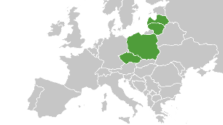
ECO BALTIA CORE STRENGHTS
The leading high-growth Baltics waste management provider,
which covers the entire waste management value chain, making it a
unique investment opportunity in circular economy and
ESG frontrunner in the region
HIGH ENTRY BARRIERS
Eco Baltia owns a very optimized distribution network of plants across Latvia and Lithuania, making it difficult for any company to compete
LONG-TERM COOPERATION WITH MUNICIPALITIES
HIGHLY EXPERIENCED
C-LEVEL TEAM
COMPREHENSIVE SERVICES PORTFOLIO
Eco Baltia companies represent unique one-stop shop for B2B clients with waste management needs
RESILIENT AND SUSTAINABLE FINANCIAL PERFORMANCE
VERTICAL INTEGRATION
Eco Baltia, thanks to its vertically integrated business units, is able to offer comprehensive waste services that ultimately allow for higher margins
SUPPORTIVE EU REGULATIONS FOR POLYMERS INDUSTRY AND PACKAGING RECYCLING
Company rankings are determined through peer comparison based on turnover data sourced from commercial registries.

Slide 7






LAST 10 YEARS OF ECO BALTIA
EBRD becomes a signiﬁcant minority shareholder in the Issuer (~10M EUR of new equity was provided in exchange for 30% of shares).
Acquisition of the leading Lithuanian WM operator Ecoservice completed, with reﬁnancing of the pan-Baltic WM segment.
Acquisition of the road and street maintenance companies Pilsetas Eko Serviss, PES serviss and B124.¹
Aquisition of Metal Plast on November 2023.
PET Baltija has relocated its rPET production plant to the adjacent facility.
Nordic Plast invests 2.5M EUR in a new upgraded plant.
PET Baltija invests 1.2M EUR in a new PET bottle processing and ﬂake production line.
Buyout of minority stakes in LZP, JUM (full buyout) and PTB (partial buyout) completed.
2013
2015
2017
2020
2022
2024
2014
2016
2018
2021
2023
Launch of the 1st high-quality rPET pellets production facility in the Baltics.
Eko Kurzeme invests
2.8M EUR in a new waste sorting plant in Liepaja, with a processing capacity of 22 k t. of household waste per year.
Four EU grants for funding development of the recycling segment are secured (total amount of ~4M EUR).
INVL Baltic Sea Growth Fund acquires 52.81% of shares in the Issuer. Overhaul of development strategy of the Issuer is completed.
Acquisition of TESIL Fibres completed with expansion outside of the Baltics.
Acquisitions of 40.4% stake in the Latvian road maintenance company in Daugavpils (Daugavpils Spec. ATU)
PET Baltija invested ~2M EUR in expansion of the rPET pellet production facility.
Eco Baltia vide wins new Riga MSW collection tender, doubling the market share in the respective area.
¹ Pilsētas Eko Serviss, PES serviss and B124 have been reorganized into Eco Baltia vide as of 01.12.2023.

Slide 8
02
ORGANIZATIONAL & BUSINESS STRUCTURE

Slide 9
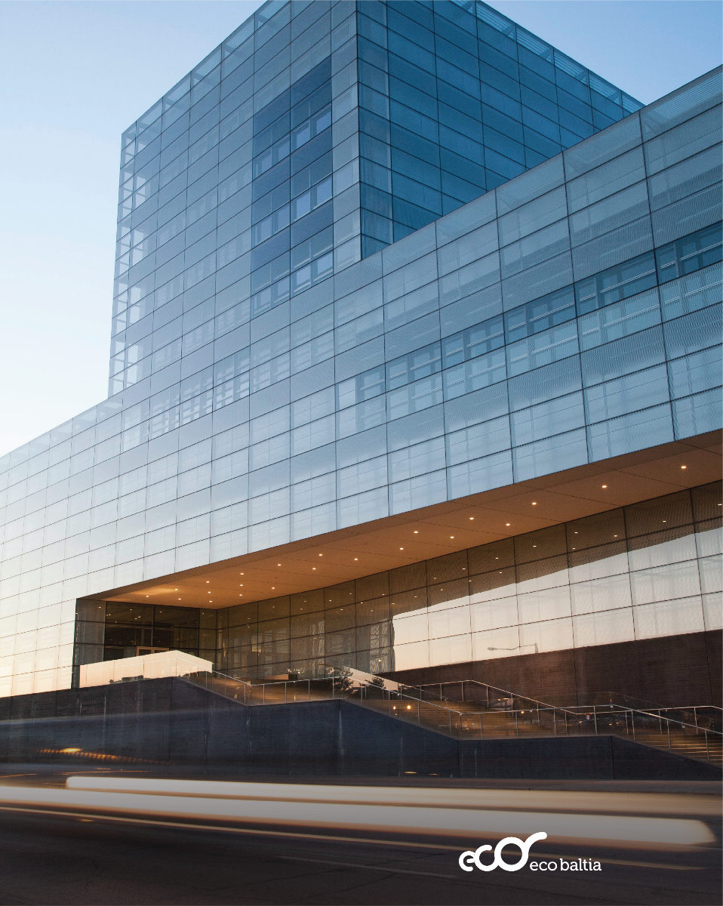


SHAREHOLDER STRUCTURE OF ECO BALTIA

Slide 10
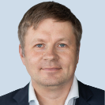

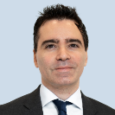
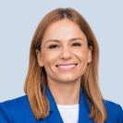
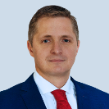
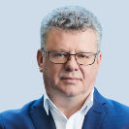
SUPERVISORY BOARD
VYTAUTAS PLUNKSNIS
Chairman of Supervisory Board at Eco Baltia
DEIMANTE KORSAKAITE
Deputy Chair of the Supervisory Board at
Eco Baltia
ALBERTO ATIENZA GUELL
Member of Supervisory Board at Eco Baltia
JURGITA PETRAUSKIENE
Independent Member of Supervisory Board at
Eco Baltia
GINTS PUCĒNS
Member of Supervisory Board at Eco Baltia
ALGIMANTAS MARKAUSKAS
Member of Supervisory Board at Eco Baltia
Vytautas has extensive experience in international investment management. As Head of INVL Private Equity, Vytautas has been involved in various large-scale investment projects for INVL in Lithuania, Latvia, Moldova and Norway.
Deimante is recognized as one of the leading M&A experts in Lithuania with extensive experience in transaction structuring and negotiations, legal due diligence. Advised local and international clients on deals with the combined value of almost €2 bn.
Alberto has extensive experience in public and private equity and quasi-equity transactions across a wide range of industries (with a focus on healthcare & pharma, manufacturing & services, consumer goods, and retail) and geographies, having executed high proﬁle investments in CEE, SEE and Turkey. Currently he is Associate Director in EBRD’s Equity team based in London.
Jurgita is a certiﬁed board member (with 15+ years of industry experience in water supply, waste-water, waste management) with competencies in investment projects, innovation, strategic planning and management.
Gints has extensive experience in advising on acquisitions, disposals, and restructuring of companies. Gints provides legal advice on corporate governance and sharehaolders issues. Legal support in fundraising for both established businesses and agile start-ups.
Algimantas is acknowledged as a robust leader and accomplished manager. With over 14 years of experience in senior roles at Thermo Fisher Scientific, he developed company’s subsidiary in Vilnius, which was acclaimed as the most valuable company in the Baltics in 2022. His forte lies in crafting and executing corporate strategies.
Notes:
Pievienoju, ja no dizaina izmaiņas tiek veiktas nākamajā, tad arī šajā nepieciešams.

Slide 11
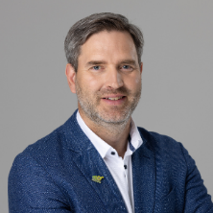
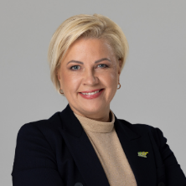
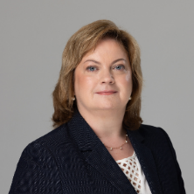
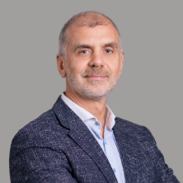
GROUP MANAGEMENT TEAM
MĀRIS SIMANOVIČS
Chief Executive Officer
& Founder
SANTA SPŪLE
Chief Financial Officer &
Board member
SIGITA NAMATĒVA
Chief Legal Officer & Board member
SAULIUS BUDREVIČIUS
Board member
More than 20 years in the environment industry
One of the most highly regarded managers in the environmental segment in Latvia. Under Māris’ management Eco Baltia has successfully evolved into an regional player with significant growth opportunities. He is actively seeking new ways to foster further business development
More than 20 years in accounting, audit and finance
In her professional career Santa has served as a CFO in various companies. Santa’s key priorities are oriented towards budgeting, performance assessment, fundraising, standardization of accounting across the group, internal and external audits
More than 20 years in law
Sigita is one of the most experienced lawyers in the ﬁeld of waste management and environmental issues. She has taken part in development of numerous waste management legislation changes in Latvia and Brussels
More than 20 years in the environment industry
Saulius is responsible for overseeing research and development initiatives, as well as the successful implementation of various investment projects within the Group
Notes:
Pievienoju, ja no dizaina izmaiņas tiek veiktas nākamajā, tad arī šajā nepieciešams.

Slide 12
03
BUSINESS SEGMENTS

Slide 13
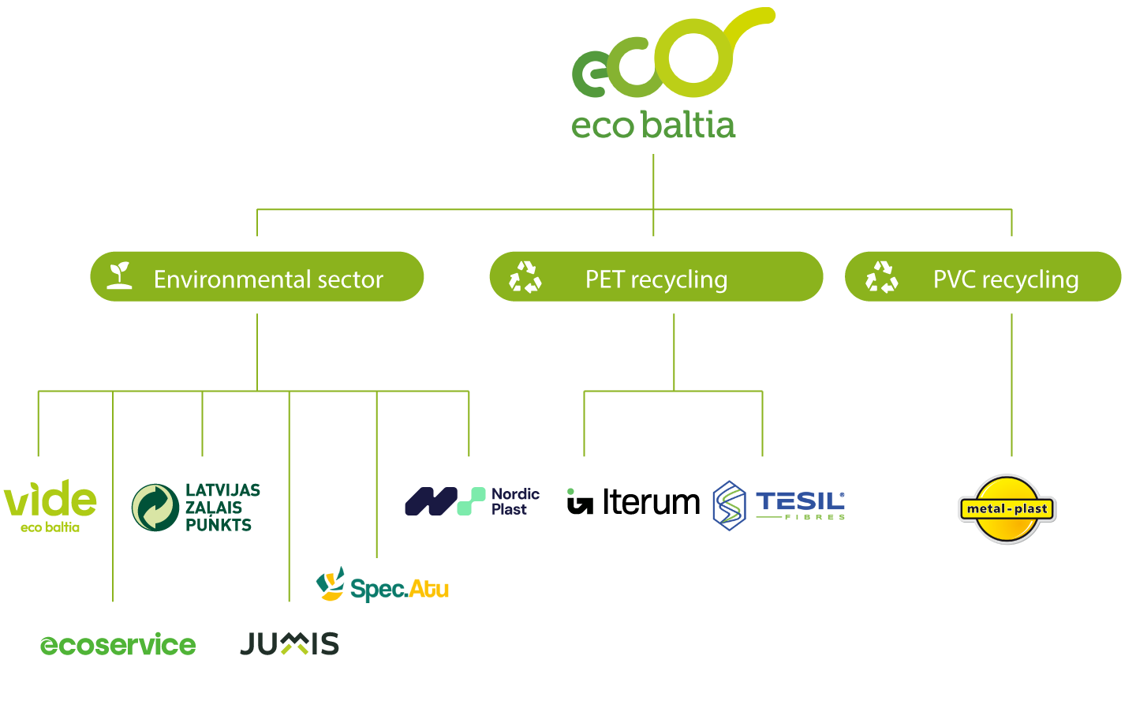


KEY SEGMENTATION OF THE GROUP
WASTE COLLECTION
TRADE OF SORTED RECYCLABLES
PRODUCERS RESPONSIBILITY ORGANISATION
LIQUID WASTE & BIO TOILETS
STREET CLEANING AND STREET MAINTENANCE SERVICES
CONSTRUCTION WASTE COLLECTION AND SORTING
PET RECYCLING
POLYETHYLENE TEREPHTHALATE (PET) RECYCLING
FIBRE PRODUCTION
PVC RECYCLING
PVC post-production scrap recycling

Slide 14



ENVIRONMENTAL SERVICES COMPANIES
Roots dating back to 1996, through consolidation of three experienced waste management companies. Eco Baltia vide is a leading environmental management company offering a comprehensive spectrum of services, including household and sorted waste removal, used packaging management, handling of debris and large-scale waste, territory cleanup, seasonal services, and composting toilet solutions
~544
employees
63.6 M EUR
revenue (2023)
Established in 2000 as the first business unit of Eco Baltia and acts as an organizer of the regeneration system. Organizes recycling of packaging waste, waste of electrical goods and environmentally harmful products in accordance with a multi-year action plan of the Latvian State Environmental Service.
~15
employees
12.7M EUR
revenue (2023)
Established in 1995, market-leading environmental services company in Lithuania, specializing in collection, transportation and processing of municipal solid waste, sorted recyclable materials, construction waste, auxiliary waste and mobile toilet rental services. Owns critically significant infrastructure in this segment.
~1 271
employees
65.1M EUR
revenue (2023)
Established 1991, the Company provides waste management services in the Sigulda City and Eco Baltia is managing JUMIS under concession agreement with Sigulda Municipality till 2033 by using all rights and obligations of the shareholder.
~18
employees
1.8M EUR
revenue (2023)

Slide 15



RECYCLING SEGMENT COMPANIES
Founded in 2003, specialises in used PET (polyethylene terephthalate) bottle secondary recycling by producing high quality PET ﬂakes and pellets. One of the largest in Northern Europe and the only recycling company of this kind in Latvia. Currently executing major capacity increase project.
~233
employees
43.8M EUR
revenue (2023)
Established by spin-off in 2022, primary producer of polyester ﬁber in the Czech Republic. Known for its high-quality standards, TESIL Fibres is the leading recycled ﬁbre supplier in the European market for the: automotive, hygiene, textile and furniture industry segments.
29.8M EUR
revenue (2023)
~93
employees
Established in 2000, recycling company specialising in recycling PP, LDPE ﬁlm and hard plastic HDPE. One of the leading polyethylene recycling companies in Latvia.
~90
employees
8.2M EUR
revenue (2023)
Leader in the PVC post-production scrap recycling market, constantly operated in this industry since 1993. Located in Poland.
~184
employees
28.4M EUR¹
revenue (2023)
¹ Pro-forma for full-year 2023, acquired in November 2023.

Slide 16
BUSINESS ENVIRONMENT
Although the waste management market in the Baltics is relatively smaller when compared to larger regions like Western Europe, Eco Baltia maintains a strong foothold in its operational domain. Eco Baltia holds the following positions:
Eco Baltia is the largest entity within the environmental services segment in Lithuania;
It ranks as the second largest privately-owned municipal waste collection company in Latvia and stands as the primary market leader in waste recovery organization within Latvia.
Latvia and Lithuania are far behind Nordic economies and fall below the European Union's average in waste generation. As the Baltic states continue to narrow the gap in terms of GDP and living standards compared to the EU average, we can anticipate a similar convergence in waste generation trends.
The flow of waste generation is steadily on the rise, and as we move toward reduced landfill usage, we anticipate a significant enhancement in both the processing and recycling segments of the business.
¹ https://ec.europa.eu/eurostat/databrowser/bookmark/490c5bef-d685-408b-a44b-ca1ce0d5b137?lang=en
² https://ec.europa.eu/eurostat/databrowser/bookmark/5e5554c6-c458-443d-90d6-13f4ca887f33?lang=en
³ https://ec.europa.eu/eurostat/databrowser/bookmark/61efd146-a202-4b30-9ecf-f24d86accaf1?lang=en

Slide 17

04
FINANCIALS

Slide 18
KEY FINANCIAL HIGHLIGHTS
Strong growth with robust proﬁtability
EBITDA growth: considerable increase, M&A activities contributing 30-40% to total growth
Environmental Services
segment Growth:
  2021: Driven by Riga MSW agreement and market share
  2022: Continued unit revenue growth
  2023: Acquisition effect of Pilsētas Eko Serviss
Plastics Recycling segment Growth:
  Driven by "Green" trend
  Major brands using reusable materials
  Increased packaging demand due to COVID-19
  Acquisition of Metal Plast in 2023
Notes:
Revenue and EBITDA results are pro-forma to reflect full-year effect of acquisitions.
* Pro-forma EBITDA reported as per IFRS, with the exception of 1.2m EUR Tesil fibres Jan-Sept '22, which is according to Czech GAAP due to carve-out.
** Ecoservice pro-forma result for Jan-Aug’21.
*** Tesil fibres pro-forma result for Jan-Sep’22.
**** Metal Plast pro-forma result for Jan-Oct’23.
***** Includes Hold co. and other cost centers.

Slide 19
KEY FINANCIAL HIGHLIGHTS
Increasing leverage driven by growth
Total book assets have been growing along with the overall business expansion
Substantial growth of balance sheet, associated with recent development CAPEX and M&A
The decline in EBITDA margin in 2022 was primarily influenced by fluctuations in energy prices. However, the focus remains on achieving favorable terms in the medium to long term
Moderate level of net debt presents growth opportunities through M&A or CAPEX
CONSOLIDATED NET DEBT/(NET CASH)
CONSOLIDATED RELATIVE LEVERAGE METRICS
120
100
80
60
40
20
0
-20
4.0x
88.3
3.6x
3.2x
3.0x
2.6x
2.5x
56.6
39.6
2.0x
2.2x
98.5
2.0x
64.7
1.4x
1.4x
6.0
51.4
1.1x
1.0x
0.8x
0.8x
9.8
-10.2
0.2x
-3.8
-11.8
-8.1
0.0x
2020
2021
Cash
2022
Debt
2023
2020
Debt-to-EBITDA Debt-to-equity
2021
2022 2023
Net-debt-to-EBITDA
Notes: Financials are reported as per IFRS. Debt exc. IFRS16 lease liabilities.
Notes:
Margins – OK.
Assets/ Equity OK
Debt – OK
Leverage metrics – OK

Slide 20







LEADER IN ADOPTION OF ESG STANDARTS
Increased attention to Sustainability and Circular Economy
  34% of waste collected by use of
  green fuel¹
  2.5% Accident rate for full-time equivalent employees¹
  15% of energy consumed from renewable energy in 2022
  31% female vs 69% male – gender split in EB companies’ senior management
  EUR 265 000 Donated to support Ukraine by Eco Baltia in 2022
  Carbon-negative
Adopted ESG strategy
Socially responsible business activities, observance of principles of fairness and transparency, ensuring sustainable development of the Group companies
The Group is currently developing individual ESG strategies for each Group company
Leader in transformation of vehicle fleet to low emission vehicles
Winner of ESG awards
First public ESG report planned in 2024
¹For companies based in Latvia

Slide 21

Thank you!
AS Eco Baltia Latgales street 240,
Riga, LV -1063, Latvia
investors@ecobaltia.lv
www.ecobaltia.lv

